Slide 1
Senior Project Fall Presentation Diabetic Meal Planner App

Slide 2
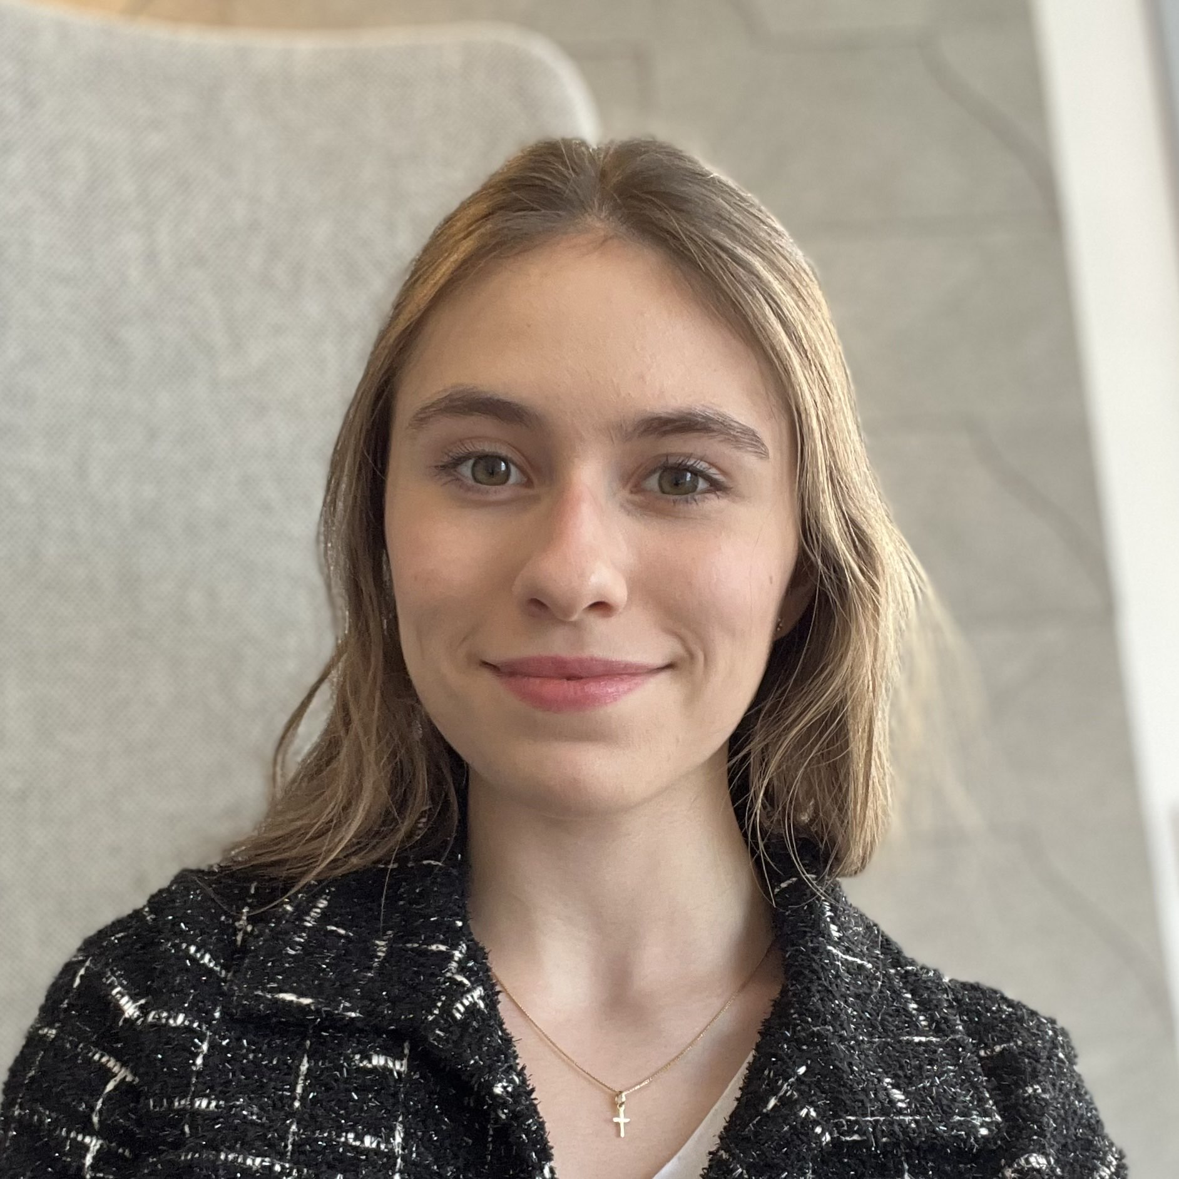
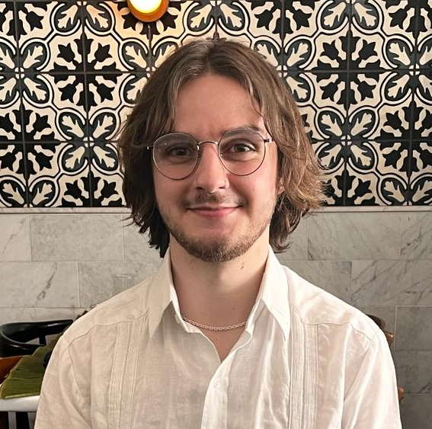
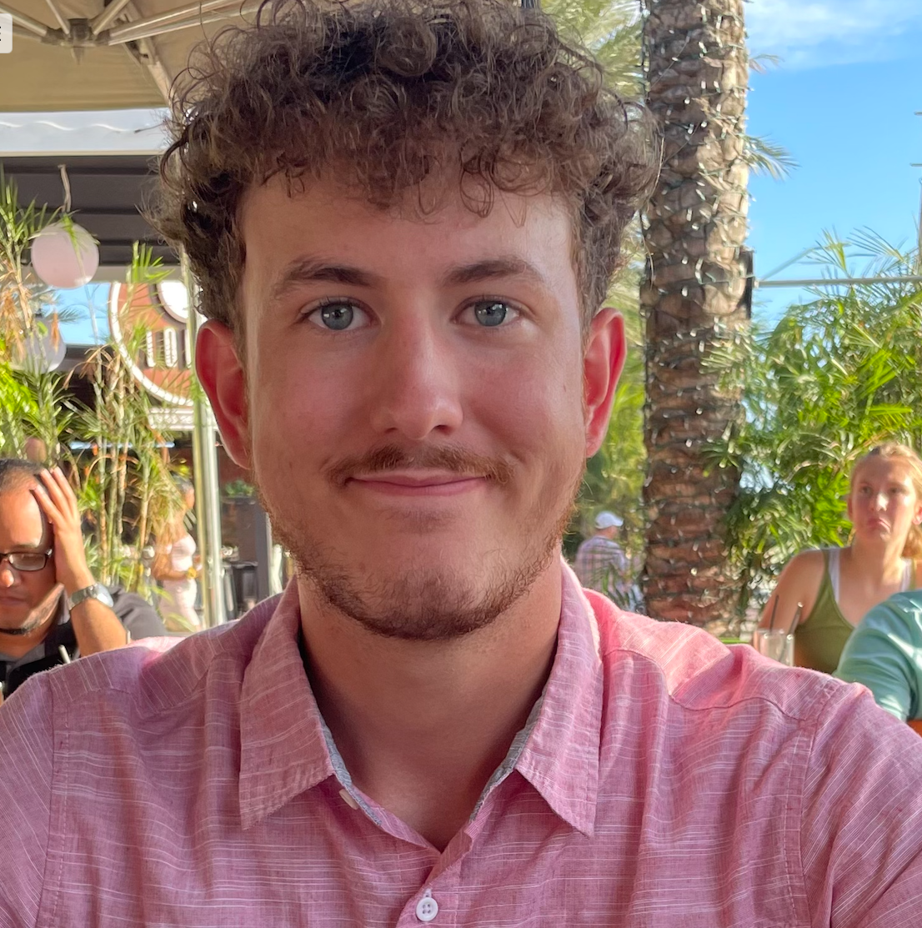

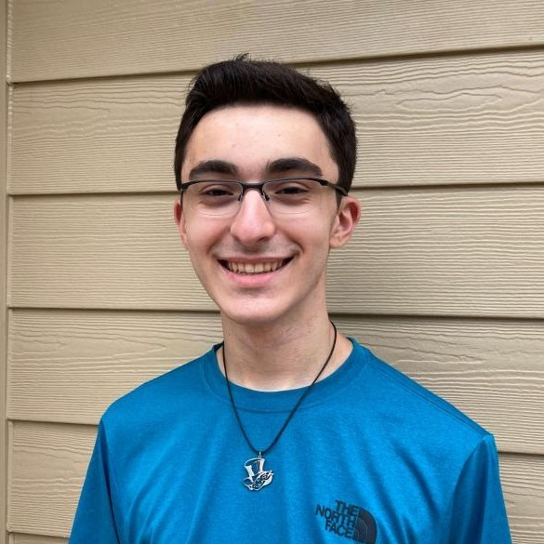
Introductions
Krisi Hristova
Computer Science
Francisco Cruz-Urbanc
Computer Science
Thomas Capro
Software Engineering
Carson Ford
Computer Science
Jared Jackson
Computer Science
Diabetic Meal Planner

Slide 3
Background
Stakeholders
2 Cooper Medical School Seniors (Rowan University)
Abyson Kalladanthyil & Ami Patel
Purpose:
Address challenges faced by diabetic patients in managing nutrition, especially those with limited income or access to resources.
Audience:
Non-tech-savvy users needing a simple, intuitive app.
Diabetic patients requiring budget-conscious meal planning with culturally relevant recipes.
Spanish speaking individuals.
Diabetic Meal Planner

Slide 4
Description
Mobile app designed to help diabetic patients manage meals, track nutrients, and save on groceries.
Empowers users to manage diabetes affordably and conveniently.
Features include recipe search, weekly meal planning, grocery list generation, and store locator.
Targets low-income, Spanish-speaking, and non-tech-savvy users.
Built for iOS using Swift, AWS, and APIs like Edamam and Google Maps.
Goal: Get the Application working correctly/efficiently and ready to deploy to Apple Store
Diabetic Meal Planner

Slide 5
Functional Requirements
Account creation.
Usage of APIs for meal recipes and map showing nearby grocery stores.
Toggle language between English and Spanish.
Search for diabetes-friendly recipes with nutrient details.
Create and track weekly meal plans.
Track daily nutrient intake (carbs, sugar, fiber).
Generate editable grocery lists with cost estimates.
Diabetic Meal Planner

Slide 6
Non-functional Requirements
Performance: Launch times under 2 seconds.
Reliability: Crash-free rates by industry standards.
Security: Secure storage & authentication (Amazon Cognito).
Robustness: Error tracking & code-review.
Design: Modularity & documentation.
Diabetic Meal Planner
Notes:
-Cold launch times: 1.5-2 seconds (app starts up from scratch)
-Warm launch times: <1 second (some of the apps processes are still running in the background before launch)
-Hot launch time: <0.5 seconds (the app is fully running in the background, system just needs to bring it to the foreground)
-Launch time targets are based on an analysis of other iOS apps, and on studies/surveys of what users expect from an app upon launch.
-Crash-free rates: >99% of all users are crash-free and >99.5% of all sessions are crash-free
-We plan to use Amazon Cognito for authentication and authorization of users, as well as encrypting and storing all user authentication data in a secure database.
-Personal user data (saved recipes, meal plans, etc.) will also be stored in a secure database.
-We will implement an error tracking system.
-Modifications to the main source code will require a code-review from at least one other developer, and it must include unit tests (if necessary) and pass all other existing unit tests in order to be merged into the source code
-The system will be built in a modular way to ensure that component functionalities can be adjusted, added, improved, removed, or exchanged without impacting the application as a whole.
-We plan to set in place a clear and standard practice for the maintenance and documentation of our code so that it is easy to read.

Slide 7

Other Accomplishments
Project Plan, Customer Requirements, SRS
Logo
GitHub Repo
Docs & Code
User Interfaces
Diabetic Meal Planner

Slide 8
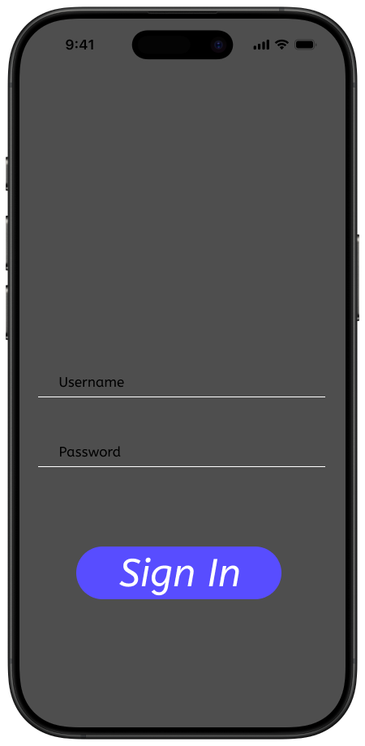
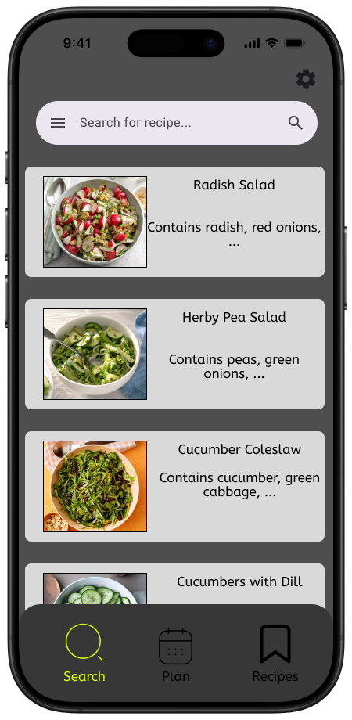
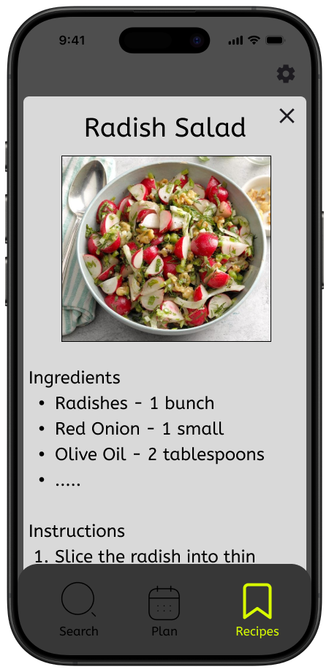
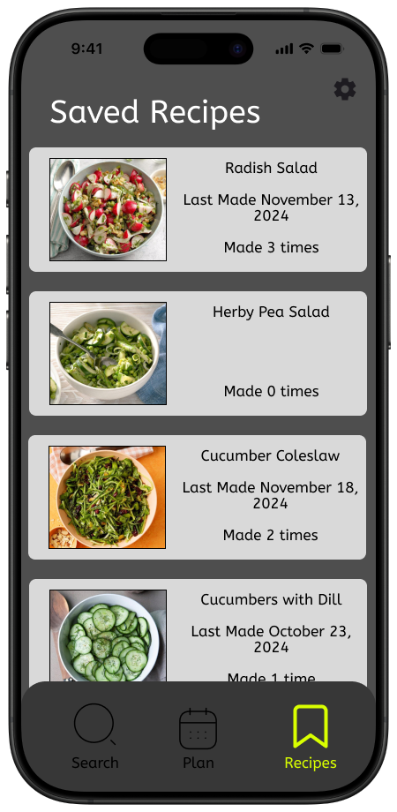
User Interfaces
Sign In Page
Recipe Search
Detailed Recipe Info
Saved Recipes
Diabetic Meal Planner

Slide 9
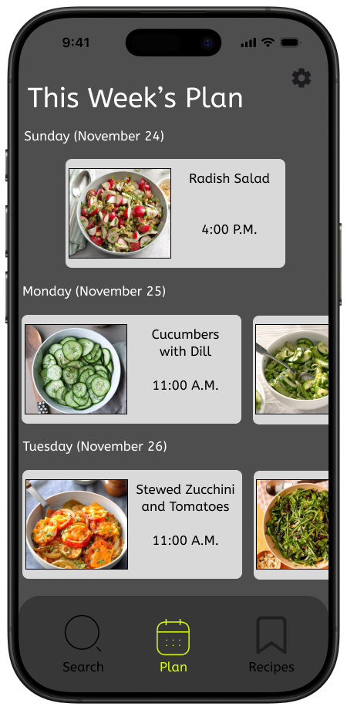
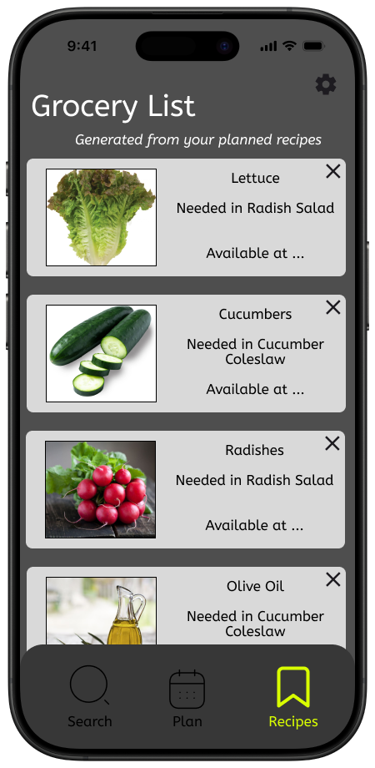
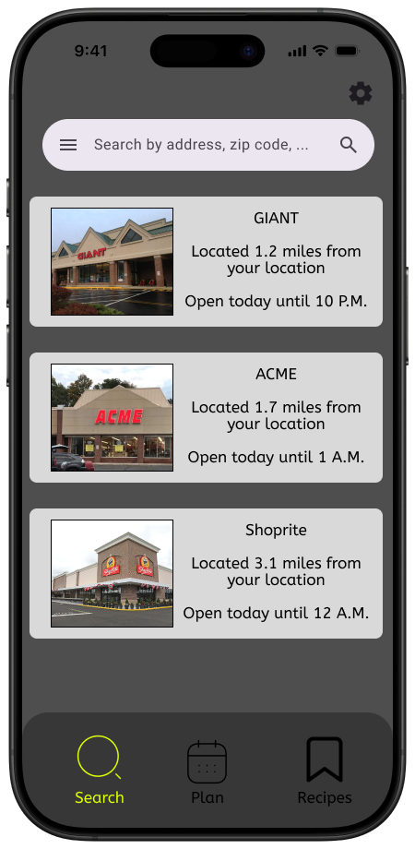
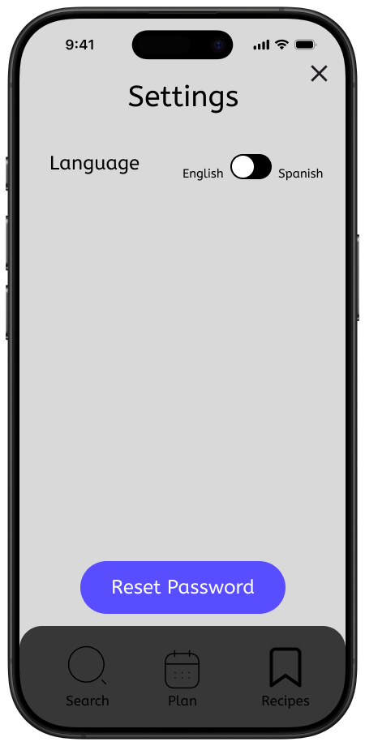
User Interfaces
Weekly Meal Planner
Grocery List Generator
Grocery Store Selection
Language Settings
Diabetic Meal Planner

Slide 10
Technical | Non-Technical Issues
iOS App Development
Xcode requires macOS for development
Everyone has obtained a Mac
Diabetic Meal Planner

Slide 11
Thank you

